Slide 2

Keyword-Driven Sentiment Analysis for Fintech News
Instructor:
Dr. Tran Van Dang
Presenters:
Pham Viet Bang – 20222143M
Le Minh Duc – 20222142M
Nguyen Sy Hong Duc - 20231061M

Slide 3
Contents
Introduction
Data Pipeline
Keyword-Driven Sentiment Analysis
Dashboard

Slide 4
Introduction

Slide 5
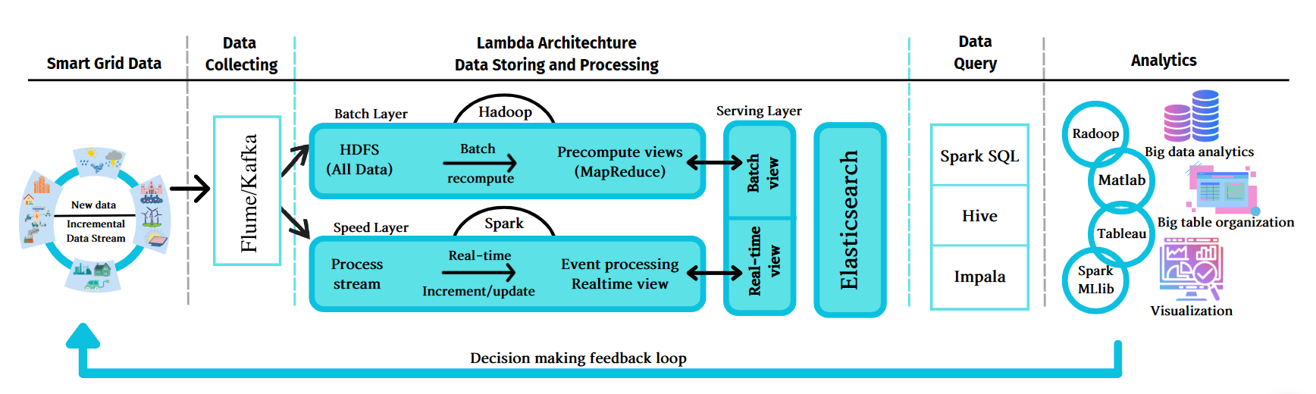
Introduction (1)
Problem: Keyword-Driven Sentiment Analysis for Fintech News
Requirements:
Deploy a lambda architecture system
Applying advanced ML/AI model for solving the problem
Build a dashboard for visualizing result
Notes:
A subfield of machine learning that deals with the task of predicting the class labels of graphs
Develop algorithms that can automatically assign a label or category to a given graph based on its structural and/or attribute information.
Applications of graph classification include social network analysis, bioinformatics, chemical informatics, and recommendation systems. Graph classification is a challenging problem due to the complex and heterogeneous nature of graphs

Slide 6
Data Pipeline

Slide 7
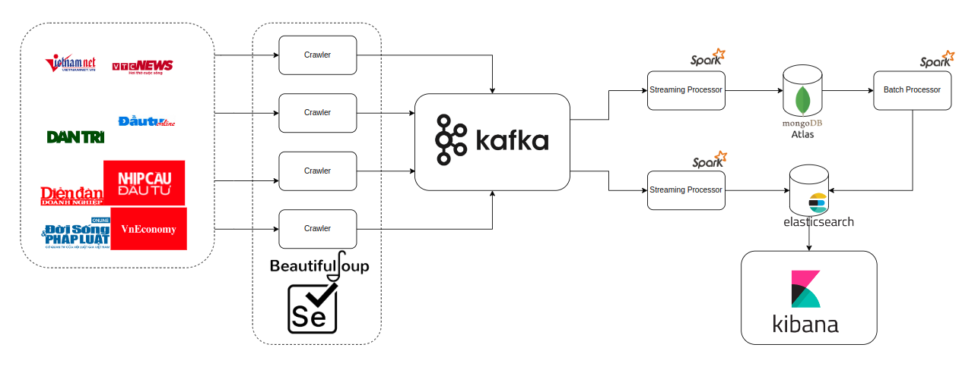

Data Piplines

Slide 8
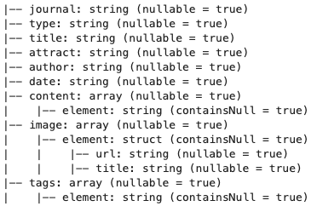


Data Pipline

Slide 9
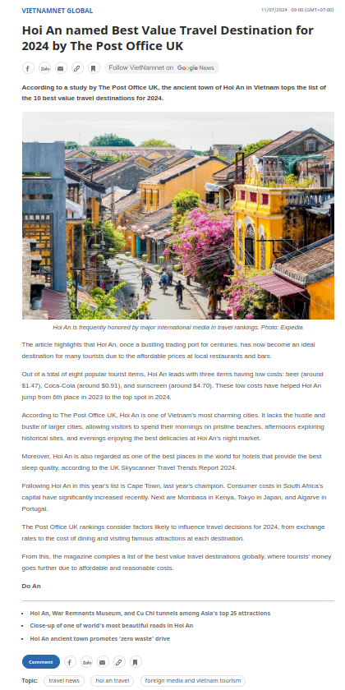
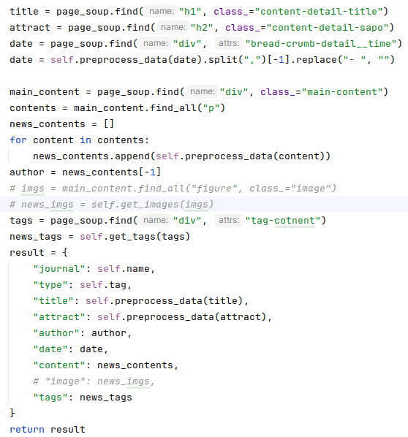
Data Pipline

Slide 10
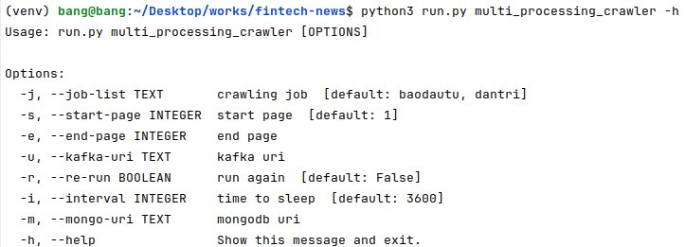
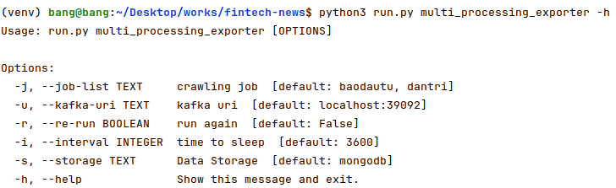
Data Pipline
Old Data
Data collection only 1 time
Import data to mongo atlas
Import data from mongo atlas to elasticsearch
New Data
Auto recrawl data after a time
Crawl 1 or 2 first pages
Import data to elasticsearch
Notes:
GRAPH2VEC is also inspired by the classic WORD2VEC paper, but instead of generating node embeddings, it is designed to generate graph-level embeddings, by treating each graph as a bag of rooted subgraphs, and adopting DOC2VEC instead of WORD2VEC. The difference between GRAPH2VEC and UGRAPHEMB is that, GRAPH2VEC is transductive (meaning it has to see all the graphs in both the training set and the testing set, and generates a graph-level embedding for each.) while UGRAPHEMB is inductive

Slide 11

Data Piplines
Notes:
GRAPH2VEC is also inspired by the classic WORD2VEC paper, but instead of generating node embeddings, it is designed to generate graph-level embeddings, by treating each graph as a bag of rooted subgraphs, and adopting DOC2VEC instead of WORD2VEC. The difference between GRAPH2VEC and UGRAPHEMB is that, GRAPH2VEC is transductive (meaning it has to see all the graphs in both the training set and the testing set, and generates a graph-level embedding for each.) while UGRAPHEMB is inductive

Slide 12
Keyword-Driven Sentiment Analysis

Slide 13


Motivation
News is collected from multiple sources, resulting in a large volume of data.
Traditionally, sentiment analysis is applied to each article individually, resulting in separate scores.
This approach is inefficient due to the high number of articles.
In this project, we propose a keyword-focused sentiment analysis.
Sentiment analysis is performed for each keyword across all articles.
This allows readers and investors to focus on keywords of interest.
Keywords can have associated sentiments (positive or negative) based on the news.
So, how do we implement this?

Slide 14



Keyword extraction (1)
When we want to understand key information from specific documents, we typically turn towards keyword extraction.
Keyword extraction is the automated process of extracting the words and phrases that are most relevant to an input text.
Statistical-based approaches are not good on semantic similarity since they are surface-level analysis with lack of context understanding.
In comes BERT. BERT is a bi-directional transformer model that allows us to transform phrases and documents to vectors that capture their meaning.
Notes:
Statistical-based approaches are built on Term Frequency (TF), Inverse Document Frequency (IDF), Word Co-occurrence, …
BERT is used because of:
. Bidirectional Context Understanding: BERT’s architecture allows it to consider the context from both the left and the right sides of a word in a sentence. This bidirectional approach is more powerful than traditional left-to-right or right-to-left models, as it provides a deeper understanding of the context in which words are used.
2. Pre-training and Fine-tuning Paradigm: BERT introduced a novel approach by pre-training on a large corpus of text and then fine-tuning on specific tasks. This paradigm allows BERT to achieve state-of-the-art performance on a variety of NLP tasks with minimal task-specific architecture modifications.
3. Masked Language Modeling (MLM): BERT uses MLM for pre-training, where some words in the input are randomly masked and the model is trained to predict these masked words. This task helps BERT learn the deep context of words in a sentence, enhancing its language understanding capabilities.
4. Next Sentence Prediction (NSP): Along with MLM, BERT uses NSP during pre-training to understand the relationship between two sentences. This feature is crucial for tasks that require an understanding of sentence relationships, such as question answering and natural language inference.
5. Transfer Learning: BERT’s design allows for effective transfer learning. Once pre-trained, BERT can be fine-tuned on a smaller, task-specific dataset, making it highly adaptable to various NLP applications with relatively low computational cost.

Slide 15

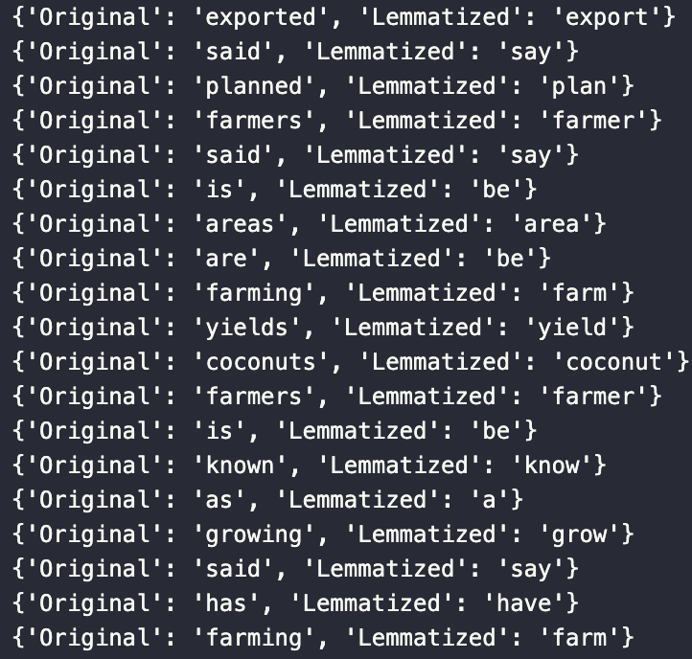


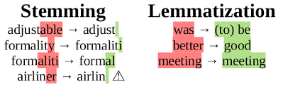
Keyword extraction (2)
Data preprocessing: Lemmatization
Lemmatization is the process of reducing words to their base or root form. It ensures that different forms of a word are treated as a single item, improving the accuracy of text analysis.
Lemmatization vs. Stemming
Lemmatization: Uses vocabulary and morphological analysis to return the base form (lemma) of a word.
Stemming: Trims word endings to get to the root form but may not return actual words.
Notes:
Provides a consistent representation of words, aiding in accurate keyword frequency counts.
Steps in the Lemmatization Process
Tokenization: Splitting the text into individual words or tokens.
Part-of-Speech Tagging: Assigning parts of speech to each token (e.g., noun, verb).
Lookup Lemmas: Using a dictionary to find the base form of each word based on its part of speech.

Slide 16

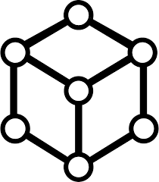
Keyword extraction (3)
Keyword Extraction Process using BERT
The sentence-transformers/all-MiniLM-L6-v2 model is a state-of-the-art pre-trained model built on top of the BERT architecture. This model is specifically designed for producing high-quality sentence embeddings, making it highly effective for various NLP tasks, including keyword extraction.
Vietnamese coconut grower and business be excite to expand production to meet the domestic and foreign demand which be be expect to increase in the come time the US US officially open it market for Vietnam fresh coconut in August this year and China be consider to allow official coconut import Duong Thuat Director of the Mekong Fruit Export Ltd Co in Chau Thanh district the southern province of Ben Tre say that the US market be the second biggest coconut importer the world just after China it import approximately 1000 container fresh coconut yearly Meanwhile Vietnamese Vietnamese company export between 110 and 120 container of fresh coconut to the US year Therefore there remains room for Vietnamese coconut in the the market Moreover the General Administration of Customs of China be inspect cultivation area to endorse protocol authorise the official import of Vietnamese fresh coconut to the market of over billion people Thuat say hop that Vietnam fresh coconut will be export to China soon To seize the opportunity he say his company plan to cooperate with coconut farmer in Ben Ben Tre province to develop 100 ha organic material Vo Van Hai the Chairman of the Luong Hoa commune Farmers in Ben Tre province Giong Trom district say that the commune be one of the most productive coconut growing area Vietnam Currently there be more than 716 ha of coconut farm in the the commune with 300 ha grown to get coconut water On average tree yield between 140 and 150 coconut per year and coconut farmer can earn earn up to 100 million VND 200 USD per hectare per year Ben Tre be know Vietnam coconut capital coconut grow area accounting about 40 of the country total and 46 of the total in the Mekong Delta region Huynh Quang Duc Deputy Director of the provincial Department of Agriculture and Rural Development say that Ben Tre have over 78 000 ha under coconut farm and produce produce over 800 million coconut year Regarding grown to get coconut water the province cultivates nearly 16 000 ha with yearly output of about 390 million coconut About half of the coconut meet export requirements Tre have five enterprise that export fresh coconut to market include Japan Singapore Taiwan China Australia Australia and Canada About 20 company have register to get packaging facility code and plant area code that enable them to export coconut to the the Chinese market Besides geographical indication have be grant to the province coconut product Therefore the effective exploitation of the geographical indication add an advantage for Ben Tre coconut to expand expand it markets
Notes:
lemmatize(text): Pass the lemmatized text to the method.
keyphrase_ngram_range=(2, 4): Specify the range for the n-grams to consider, here from 2 to 4 words.
vectorizer=KeyphraseCountVectorizer(): Use KeyphraseCountVectorizer to count the occurrences of keyphrases.
use_mmr=True: Enable Maximal Marginal Relevance (MMR) to diversify the keywords.
diversity=0.4: Set the diversity parameter to 0.4, balancing relevance and diversity.
top_n=200: Extract the top 200 keywords.
KeyphraseCountVectorizer is designed to count the occurrences of keyphrases (n-grams) in a text. It provides a way to extract meaningful phrases that can represent the core content of the text. This is particularly useful in natural language processing (NLP) tasks where understanding the context and main themes of a document is essential.

Slide 17

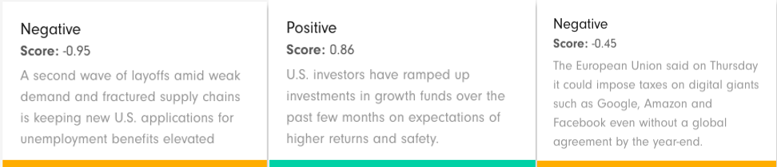
Sentiment analysis
Sentiment analysis using BERT
FinBERT is a pre-trained language model based on the BERT (Bidirectional Encoder Representations from Transformers) architecture, specifically fine-tuned for financial text analysis. It leverages the vast amounts of textual data in financial documents to understand and interpret nuanced financial language. FinBERT excels in tasks such as sentiment analysis, named entity recognition, and document classification within the finance domain.

Slide 18





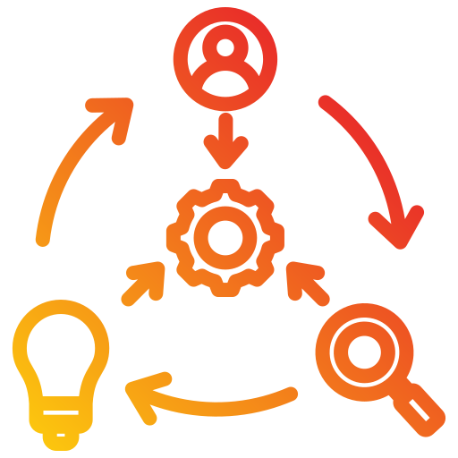

Overall process
Interested topics/keywords
Parallelization
User-demand synthetic information
Visualization
Notes:
1. Web Scraping (BeautifulSoup):
• The process begins with web scraping, where data is extracted from multiple sources using BeautifulSoup, a Python library for parsing HTML and XML documents. This step gathers raw data from various websites or databases.
2. Data Ingestion (Kafka):
• The scraped data is then sent to Kafka, a distributed streaming platform. Kafka acts as a message broker, allowing the system to handle large volumes of data efficiently and stream it to different components in real-time.
3. Data Processing (Apache Spark):
• The data from Kafka is processed using Apache Spark, an open-source unified analytics engine. Spark performs parallel processing, enabling the system to handle and process large-scale data quickly. This step might include data cleaning, transformation, and enrichment.
4. Data Storage and Indexing (MongoDB Atlas and Elasticsearch):
• Processed data is stored in MongoDB Atlas, a cloud-based NoSQL database. MongoDB Atlas provides scalable and flexible storage solutions.
• Simultaneously, the data is indexed in Elasticsearch, a distributed search and analytics engine. Elasticsearch enables fast and scalable searching and filtering of large datasets.
5. Data Analysis (Google BERT):
• Google BERT (Bidirectional Encoder Representations from Transformers) is used for natural language processing (NLP) tasks. BERT helps in understanding the context and semantics of the data, allowing for sophisticated text analysis and keyword extraction.
6. Visualization (Kibana):
• The analyzed data is visualized using Kibana, an open-source data visualization dashboard for Elasticsearch. Kibana provides interactive charts, graphs, and dashboards, allowing users to explore and interpret the data easily.
7. User Interaction:
• Users can input their topics or keywords of interest, which drives the data processing pipeline. The system generates synthetic information based on user demand, providing relevant insights and visualizations through the Kibana interface.

Slide 19
Dashboard

Slide 20
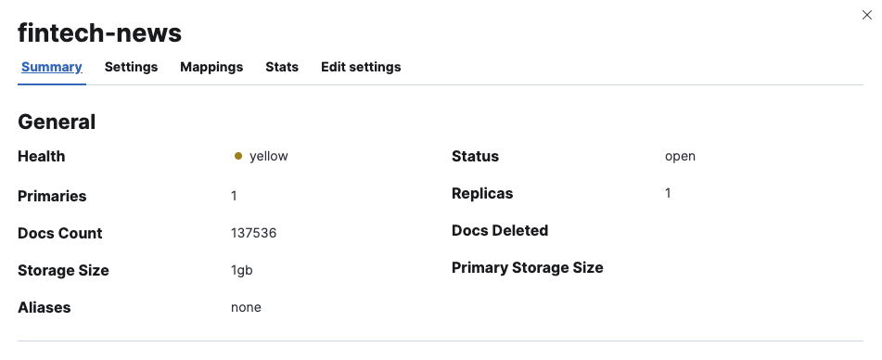
Visualization

Slide 21
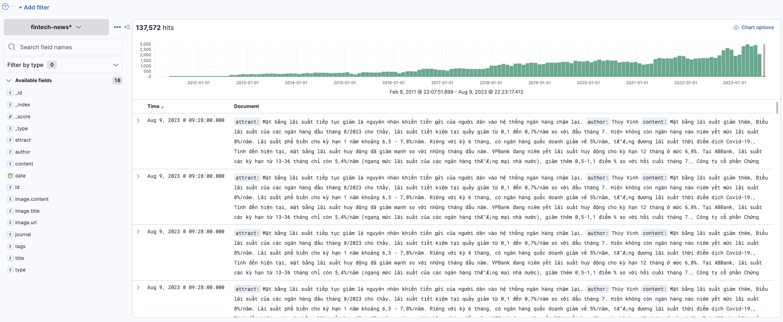
Visualization

Slide 22
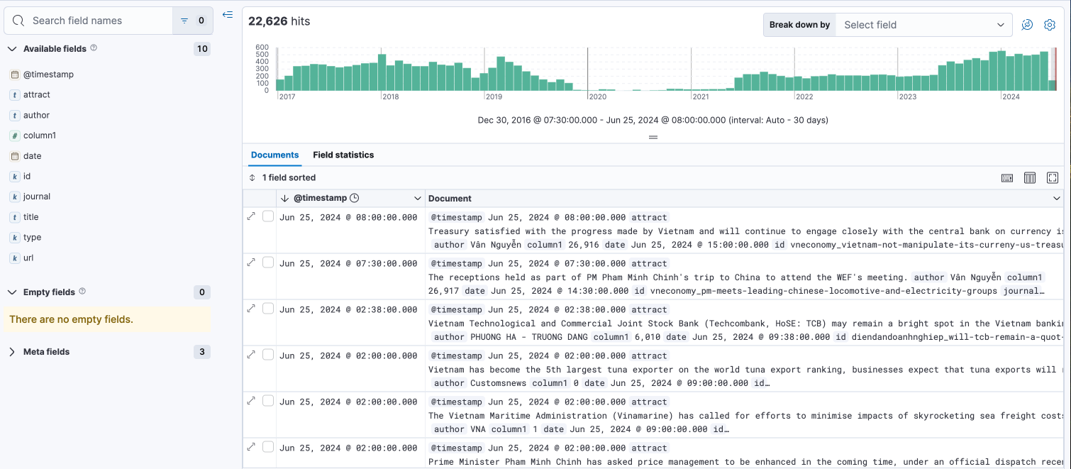
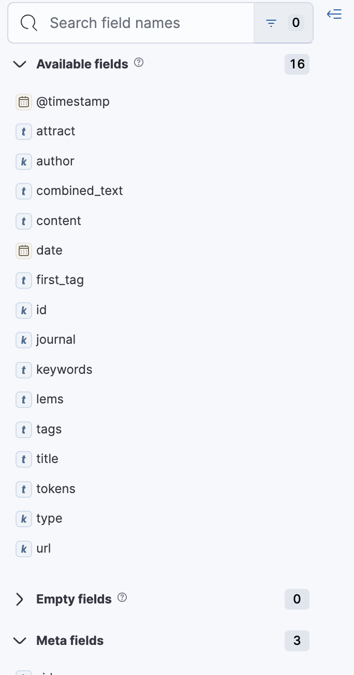
Dashboard

Slide 23
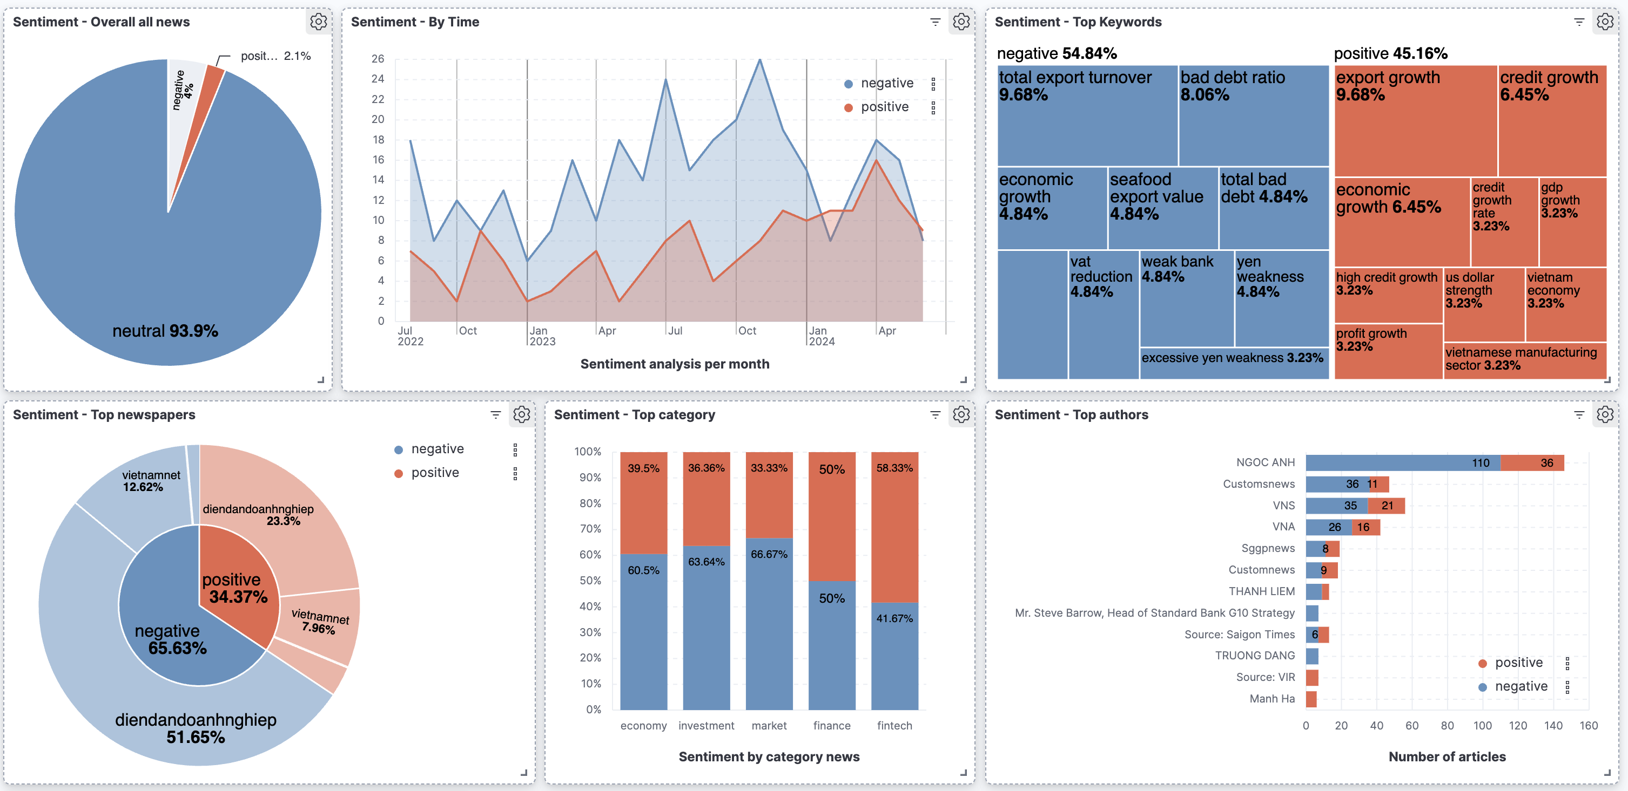
Dashboard

Slide 24
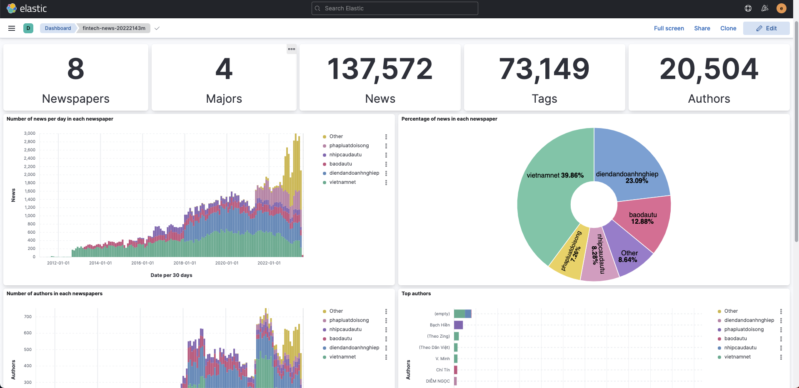
Visualization

Slide 25
THANK YOU !

